Slide 1
Machine learning
Presented by
Pushkar Sathe

Slide 2
Machine learning (ML)
Subset of Artificial Intelligence (AI)
Works in a similar way to human learning
Ability of system to independently find solution
Ability to automatically learn and improve from experience
No explicit instructions used
Builds a mathematical model based on sample data (training data)

Slide 3
ML applications
Virtual Personal Assistants e.g. Alexa
Face recognition on Facebook
Video recommendation of YouTube
Google translator
Spam detection on Gmail
Medical field : diagnosis and prognosis
Sentiment analysis

Slide 4
ML algorithm types
Supervised learning
Unsupervised learning
Reinforcement learning

Slide 5
Supervised learning algorithms
Simple linear regression
Multiple linear regression
Logistic regression
Support Vector Machine
Decision tree
Random forest
Naïve Bayes

Slide 6
Simple linear regression
Statistical method used for regression
Study of relationship between independent and dependent variables
Involves one dependent variable and one independent variable
Both the variables are continuous in nature
Model is ‘best fitting line’

Slide 7
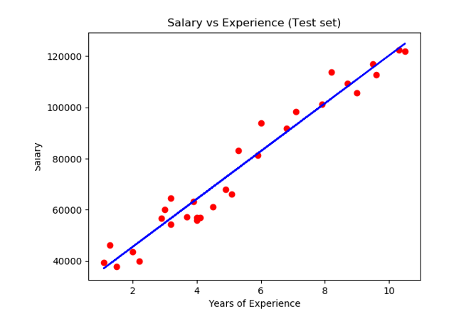
Example

Slide 8
Best fit line
y = m.x + c
Line belonging to optimum values of ‘m’ and ‘c’ is best fit line
Least square approach is used
Error = ( predicted value – actual value ) of dependent variable
Sum of squares of errors of all data points should be minimum

Slide 9
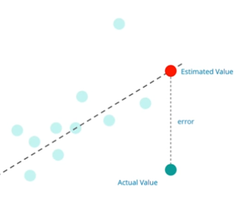
Error

Slide 10

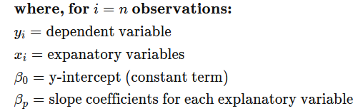
Multiple linear regression
Involves several independent variables and single dependent variable
Equation describing the relationship is

Slide 11
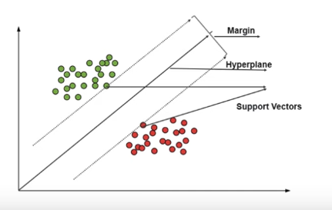
Support Vector Machine (SVM)
Discriminative classifier works on separation of hyper-planes
Very effective even when data is high dimensional

Slide 12
Working of SVM
Forms hyper plane between data points
Margin is a distance between nearest data point and hyper plane
Hyper plane giving highest margin should be selected
Forming hyper plane is difficult in case of non linear or inseparable problem
Use of Kernels : Transformation to higher dimensions

Slide 13
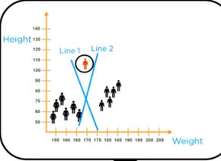
Example : SVM

Slide 14
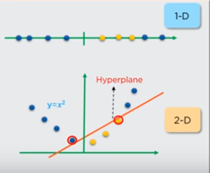
Example : Kernels in SVM

Slide 15
Types of kernels
Kernel type is selected based on distribution of data points
Linear
Polynomial
Radial Basis Function (RBF)

Slide 16
Decision tree
Can be used for classification as well as regression
Algorithm involves representation of data as a tree
Drawn upside down with its root at top
At every node one branch is selected based on feature value
Algorithm is used especially in decision making

Slide 17
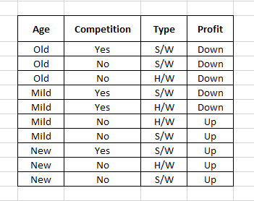
Example

Slide 18
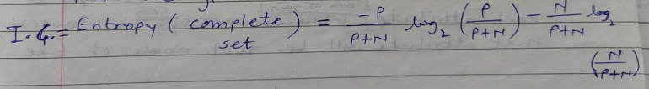


Formulae

Slide 19
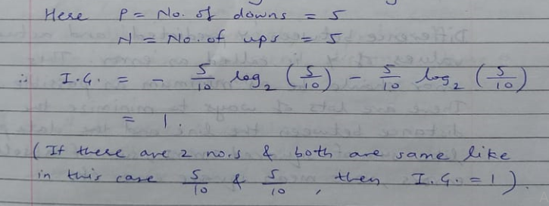
Solution

Slide 20
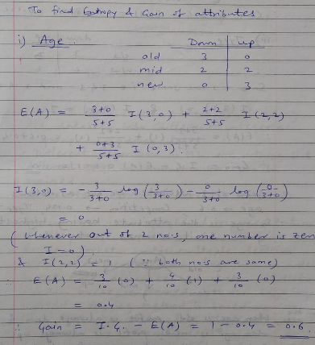
Solution

Slide 21
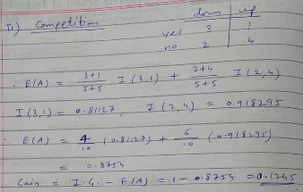
Solution

Slide 22
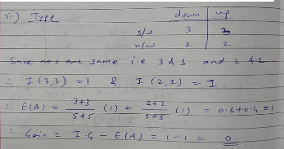
Solution

Slide 23
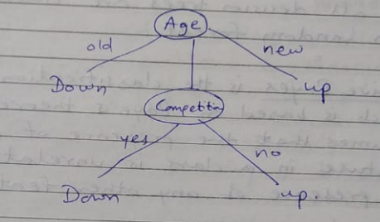
Solution

Slide 24
Random forest
Concept is based on wisdom of crowds
Consists of large number of individual decision trees
Trees should have low correlation among each other
Each tree spits out a class prediction
The class with most votes becomes model’s prediction

Slide 25
Neural network
Forms the basis of deep learning methods
Basic building block is neuron
Most traditional neural network – MLP (Multi-Layered Perceptron)
Deep Neural Network

Slide 26
Neuron
Fig. 1 : Basic structure of neuron [1]

Slide 27
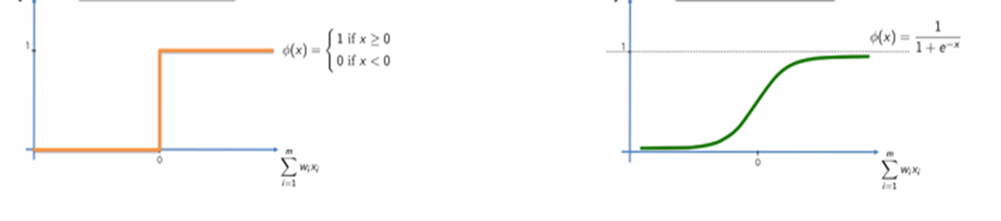
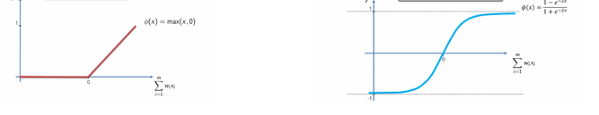
Activation function
Threshold Function
Sigmoid
Rectifier Linear Unit
Hyperbolic Tangent
Fig. 2 : Activation functions [1]

Slide 28
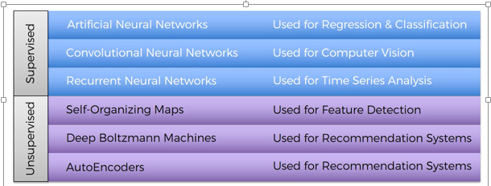
Network types and applications [1]

Slide 29
Deep neural networks
Artificial Neural Network (ANN)
Convolutional Neural Network (CNN)
Recurrent Neural Network (RNN)

Slide 30
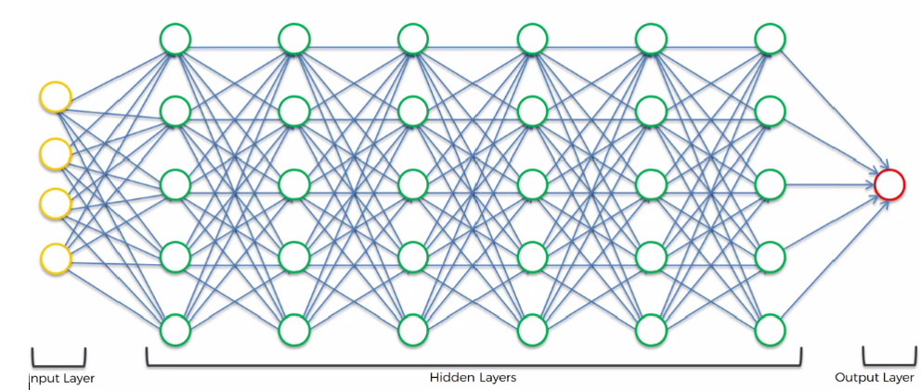
ANN
Fig. 3 : ANN Architecture [1]

Slide 31
CNN
Need of CNN
Special type of feed forward networks
Functions similar to animal visual cortex
Capable of capturing patterns from applied input image
Applications in computer vision : Face recognition
Medical diagnosis

Slide 32
Layers of CNN
Layers used: i) Convolutional layer
ii) ReLu (Rectified Linear Unit) layer
iii) Pooling layer [2]
iv) Fully connected layer

Slide 33
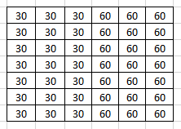


Example : Convolution

Slide 34
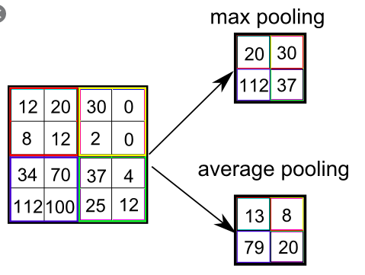
Example : Pooling

Slide 35
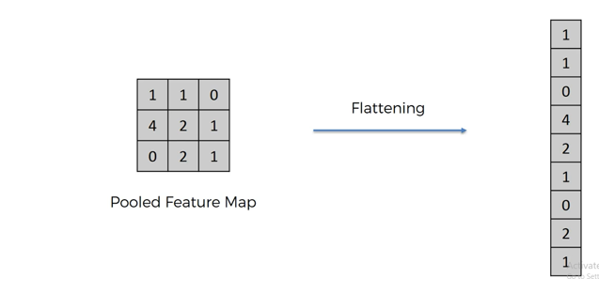
Example : Flattening

Slide 36
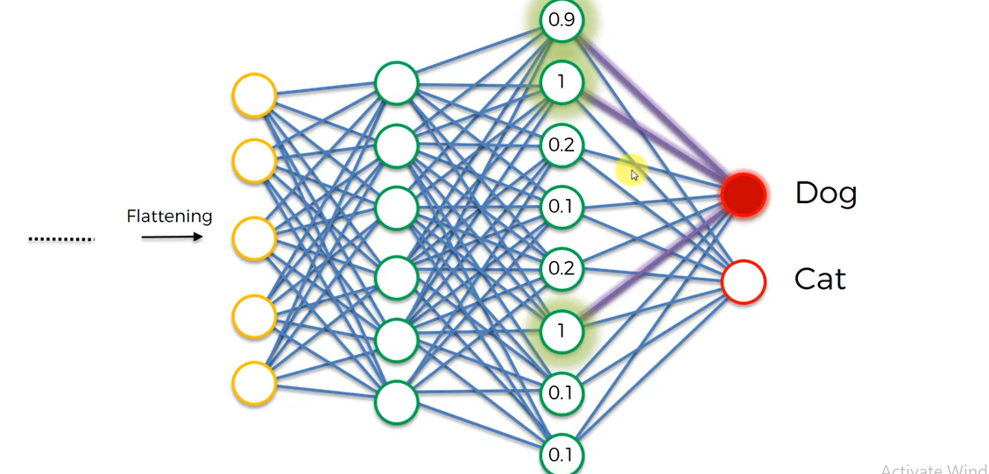
Example : Fully connected layer

Slide 37
Popular CNN architectures
LeNet
AlexNet
GoogLeNet
ResNet
VGG (Visual Geometry Group)

Slide 38
Need of RNN
In feed forward networks outputs are independent of time
In many applications we need to know previous output in order to predict next output
Need of a structure in which output at any given time is function of input applied at that time as well as some information from past

Slide 39
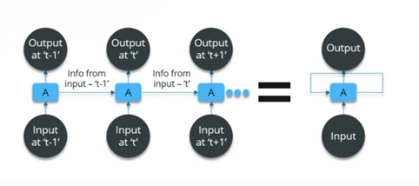
General structure of RNN
Fig. 1 : General structure of RNN [1]

Slide 40
General applications of RNN
Predicting next word in given statement
Predicting whether given statement / paragraph is positive review of something or negative.
Google translator
Writing movie subtitles
In medical field – for prognosis

Slide 41
Tensor Flow
Python library released in 2015 by Google
Used in designing, development and training of deep learning models
Tensors are dynamically sized multidimensional data arrays
Only tensors can be passed between nodes

Slide 42
Keras
It is high level neural network API capable of running on top of Tensor Flow
Supports both, convolutional and recurrent neural networks
Compatible with all versions of python
Core data structure of Keras is Model : A way to orgnaize layers

Slide 43
References
https://Medium.Com/@Camrongodbout/Recurrent-Neural-Networks-For-Beginners-Aca4e933b82
https://Medium.Com/@Camrongodbout/Recurrent-Neural-Networks-For-Beginners-Aca4e933b82
[1] Karpathygithub.io
[2] Medium.com/@Camrongodbout/Recurrent-Neural-Networks-For-Beginners
[3] Colah.github.io

Slide 44
Thank you
https://Medium.Com/@Camrongodbout/Recurrent-Neural-Networks-For-Beginners-Aca4e933b82
https://Medium.Com/@Camrongodbout/Recurrent-Neural-Networks-For-Beginners-Aca4e933b82

